Slide 1
I2C Protocol Introduction
Author: Hongjie Chen
date: 2020/09/02

Slide 2
I2C Protocol Introduction

Slide 3
I2C Introduction
The I2C-bus is a de facto world standard that is now implemented in over 1000 different
ICs manufactured by more than 50 companies. Additionally, the versatile I2C-bus is used
in various control architectures such as System Management Bus (SMBus), Power
Management Bus (PMBus), Intelligent Platform Management Interface (IPMI), Display
Data Channel (DDC) and Advanced Telecom Computing Architecture (ATCA).

Slide 4
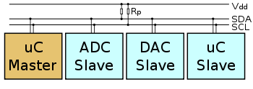
I2C bus featrues
I2C is a serial protocol for two-wire interface to connect low-speed devices like microcontrollers, EEPROMs, A/D and D/A converters, I/O interfaces and other similar peripherals in embedded systems. It was invented by Philips and now it is used by almost all major IC manufacturers. Each I2C slave device needs an address – they must still be obtained from NXP (formerly Philips semiconductors).

Slide 5
I2C bus featrues
Here are some of the features of the I2C-bus:
• Only two bus lines are required; a serial data line (SDA) and a serial clock line (SCL).
• Each device connected to the bus is software addressable by a unique address and
simple master/slave relationships exist at all times; masters can operate as
master-transmitters or as master-receivers.
• It is a true multi-master bus including collision detection and arbitration to prevent data
corruption if two or more masters simultaneously initiate data transfer.
• Serial, 8-bit oriented, bidirectional data transfers can be made at up to 100 kbit/s in
the Standard-mode, up to 400 kbit/s in the Fast-mode, up to 1 Mbit/s in Fast-mode
Plus, or up to 3.4 Mbit/s in the High-speed mode.

Slide 6
I2C bus speed
Originally, the I2C-bus was limited to 100 kbit/s operation. Over time there have been
several additions to the specification so that there are now five operating speed
categories. Standard-mode, Fast-mode (Fm), Fast-mode Plus (Fm+), and High-speed
mode (Hs-mode) devices are downward-compatible — any device may be operated at a
lower bus speed. Ultra Fast-mode devices are not compatible with previous versions
since the bus is unidirectional.
Bidirectional bus:
Standard-mode (Sm), with a bit rate up to 100 kbit/s
Fast-mode (Fm), with a bit rate up to 400 kbit/s
Fast-mode Plus (Fm+), with a bit rate up to 1 Mbit/s
High-speed mode (Hs-mode), with a bit rate up to 3.4 Mbit/s.
Unidirectional bus:
Ultra Fast-mode (UFm), with a bit rate up to 5 Mbit/s

Slide 7
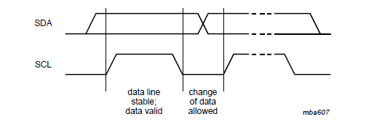
SDA and SCL signals
The data on the SDA line must be stable during the HIGH period of the clock. The HIGH
or LOW state of the data line can only change when the clock signal on the SCL line is
LOW. One clock pulse is generated for each data bit transferred.

Slide 8
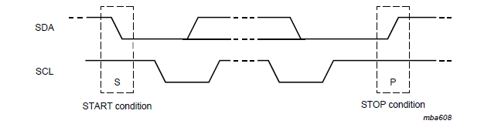
START and STOP conditions
All transactions begin with a START (S) and are terminated by a STOP (P). START and STOP conditions are always generated by the master. The bus is considered to be busy after the START condition. The bus is considered to be free again a certain time after the STOP condition.
A HIGH to LOW transition on the SDA line while SCL is HIGH defines a START condition.
A LOW to HIGH transition on the SDA line while SCL is HIGH defines a STOP condition.

Slide 9
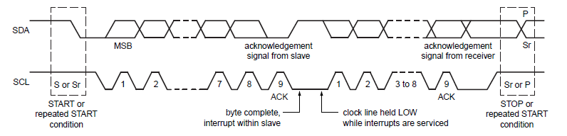
Byte format
Every byte put on the SDA line must be eight bits long. The number of bytes that can be transmitted per transfer is unrestricted. Each byte must be followed by an Acknowledge bit. Data is transferred with the Most Significant Bit (MSB) first. If a slave cannot receive or transmit another complete byte of data until it has performed some other function, for example servicing an internal interrupt, it can hold the clock line SCL LOW to force the master into a wait state. Data transfer then continues when the slave is ready for another byte of data and releases clock line SCL.

Slide 10
Acknowledge(ACK) and Not Acknowledge(NACK)
The acknowledge takes place after every byte. The acknowledge bit allows the receiver to signal the transmitter that the byte was successfully received and another byte may besent. The master generates all clock pulses, including the acknowledge ninth clock pulse.
When SDA remains HIGH during this ninth clock pulse, this is defined as the Not Acknowledge signal. The master can then generate either a STOP condition to abort the transfer, or a repeated START condition to start a new transfer. There are five conditionsthat lead to the generation of a NACK:
No receiver is present on the bus with the transmitted address so there is no device to respond with an acknowledge.
The receiver is unable to receive or transmit because it is performing some real-time function and is not ready to start communication with the master.
During the transfer, the receiver gets data or commands that it does not understand.
During the transfer, the receiver cannot receive any more data bytes.
A master-receiver must signal the end of the transfer to the slave transmitter.

Slide 11
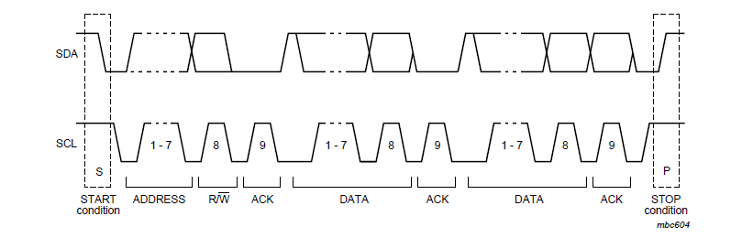
The slave address and R/W bit
Data transfers follow the format shown in Figure 9. After the START condition (S), a slave address is sent. This address is seven bits long followed by an eighth bit which is a data direction bit (R/W) — a ‘zero’ indicates a transmission (WRITE), a ‘one’ indicates arequest for data (READ) (refer to Figure 10). A data transfer is always terminated by a STOP condition (P) generated by the master. However, if a master still wishes to communicate on the bus, it can generate a repeated START condition (Sr) and address another slave without first generating a STOP condition. Various combinations of read/write formats are then possible within such a transfer.

Slide 12



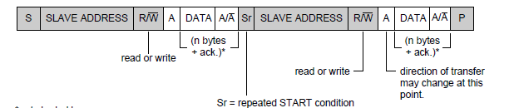
The slave address and R/W bit
from master to slave
from slave to master

Slide 13
Byte format

Slide 14
Byte format

Slide 15
Closing statement

